Slide 1
Regulating Sewage Discharge from Vessels Transport Canada Marine Safety & Security
Presentation for the Baynes Sound/Lambert Channel EcoForum
May 26, 2023

Slide 2
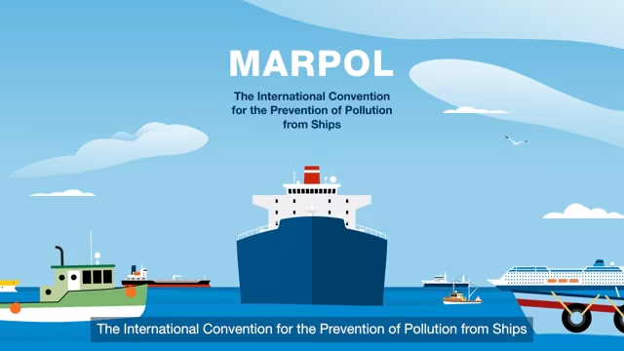
The current regime
International Convention for the Prevention of Pollution from Ships (MARPOL)
Canadian Vessel Pollution and Dangerous Chemicals Regulations (VPDCR)

Slide 3
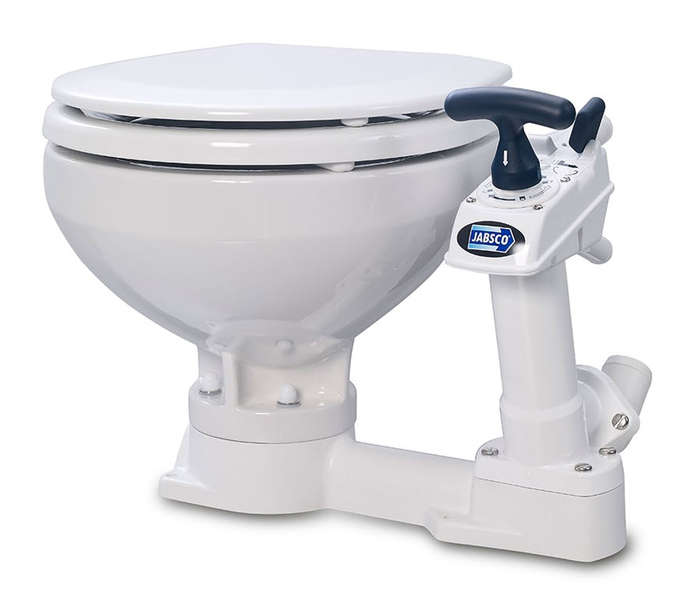
Sewage – required equipment for vessels
approved marine sanitation device (MSD)
or
holding tank with required capacity for the trip (0.56 litres/person/hour)
or
temporary storage secured to vessel (vessels <15 GT and ≤ 15 pax)

Slide 4
Sewage – how and where to discharge

Slide 5
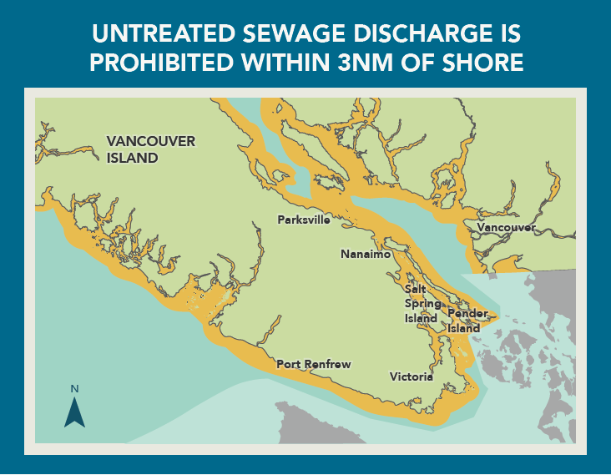

Slide 6
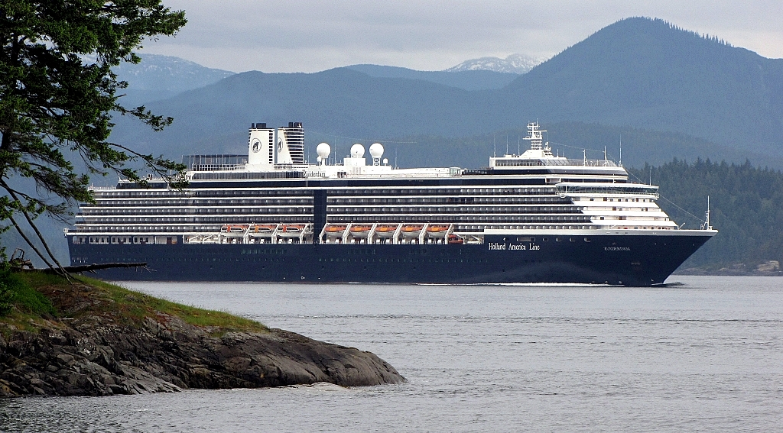
Cruise ship discharges
Enhanced environmental measures for 2023:
<3 nm: avoid discharging greywater and sewage
3 – 12 nm: treat greywater with sewage using approved device before discharging

Slide 7
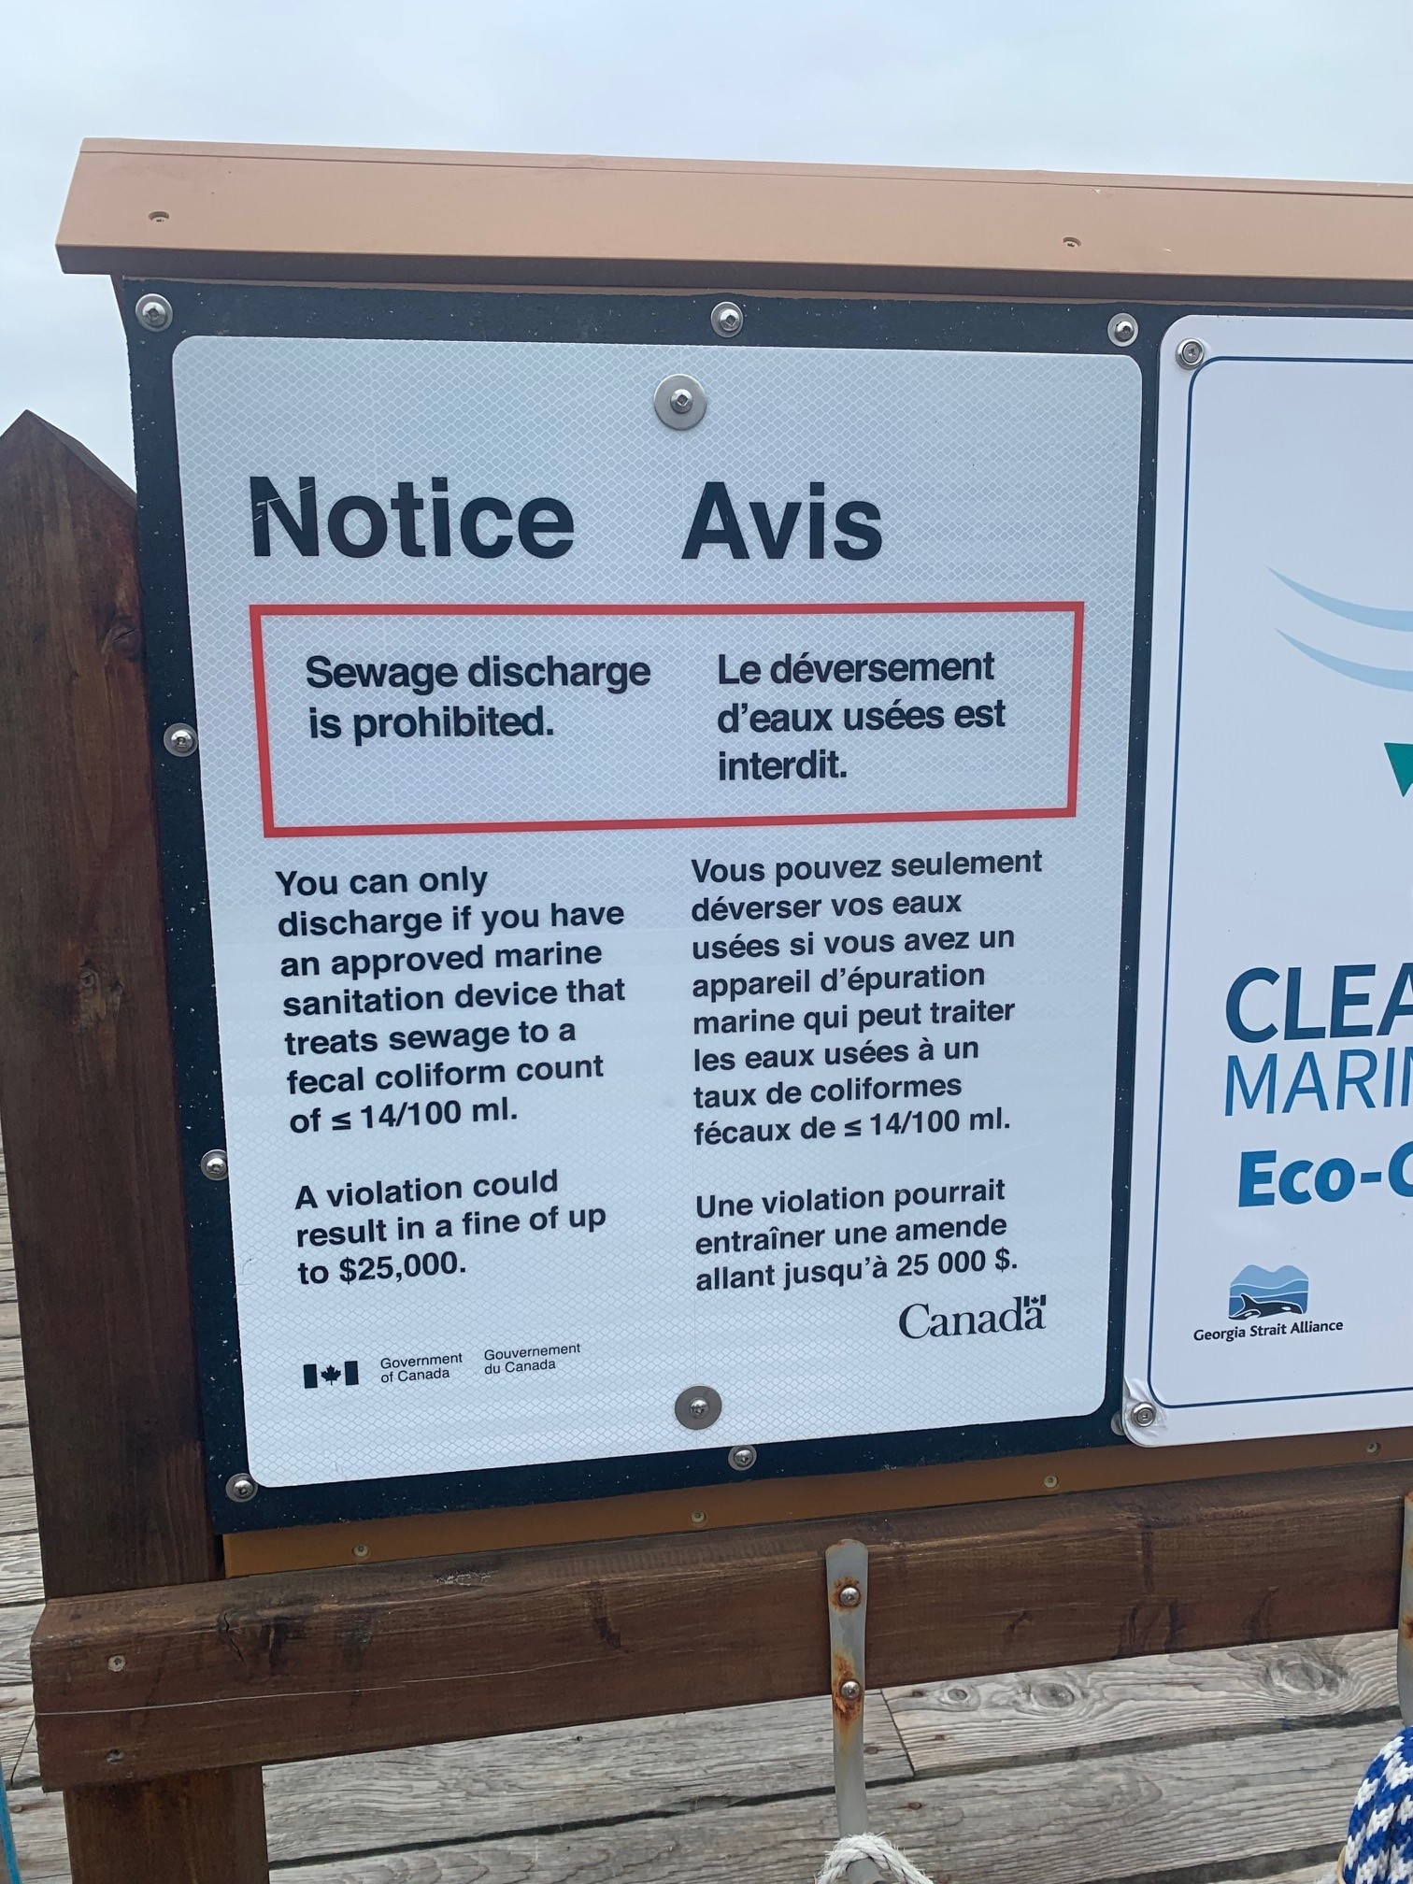
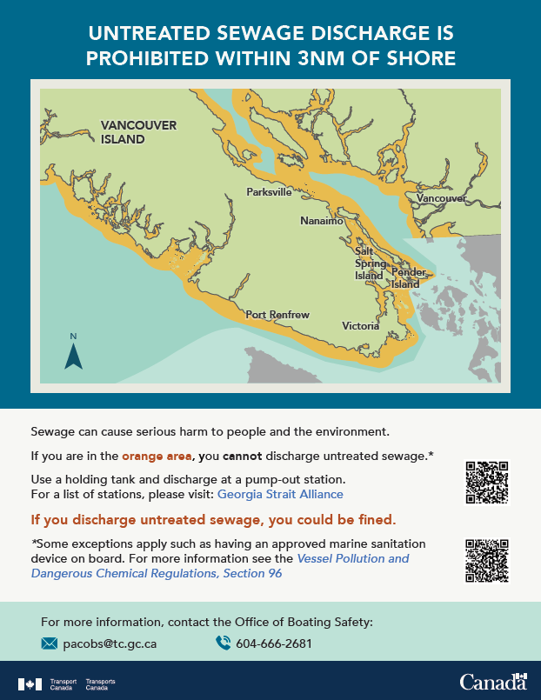
Education and enforcement
Targeted inspection campaigns – joint patrols with DFO and ECCC during fishery openings
Increased oversight of small commercial vessels
Education and outreach
(e.g. Office of Boating Safety, Harbour Days)

Slide 8
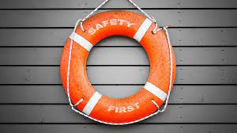
What else we’re doing…
Future amendments to VPDCR, including review and update of discharge provisions.
Engaging Indigenous groups, industry, environmental groups, other stakeholders over the next year.
Interim Order/future regulations to make permanent enhanced measures for cruise ships permanent

Slide 9
Questions?

